Slide 1
Introduction to Node.JS

Slide 2


Slide 3
ECMA is the specification/standard for JavaScript.
JavaScript is the implementation .
W3C propose standards for Web Technologies (HTML,XML, XHTML, CSS)
W3C also propose DOM API, HTML 5 WEB API

Slide 4
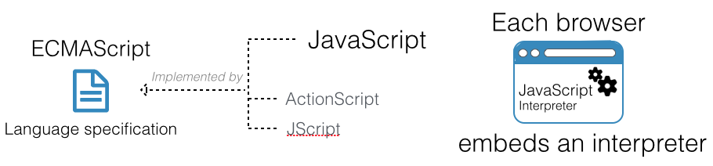
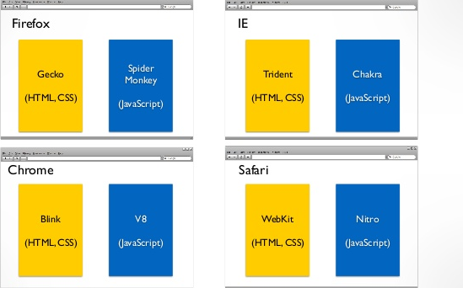

Slide 5
Major version of JavaScript
ES5 – (ECMA 262) – 2009
ES6 – 2015
ES7 – soon.
Major browsers are in processing of implementing ES6 and ES7.

Slide 6
Want to use latest JavaScript ES6,ES7?

Slide 7
Use Transpiler like Babel.

Slide 8
Client Side JavaScript
Runs in browser via Desktop, Smartphone,Tablets.
Web API – Programmatically accessing Web functionality
DOM
XMLHTTP (Ajax).
HTML5 - Storage, Location, Notification, SSE, Service Workers
Libraries
JQuery,D3.js, Processing.js
Frameworks
ReactJS, AngularJS,EmberJS,Vue.js

